Slide 1

Attention in NLP
汇报人：张璐 汇报时间：2018.12.5
延时符

Slide 2

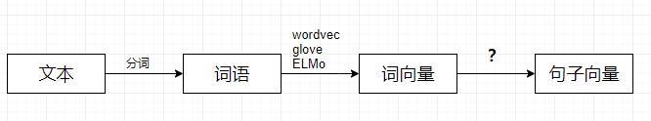
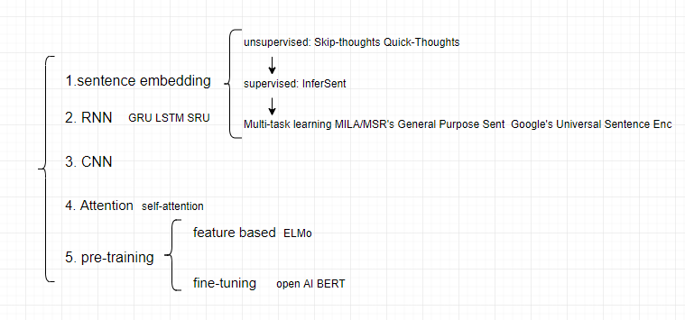
绪论
延时符

Slide 3
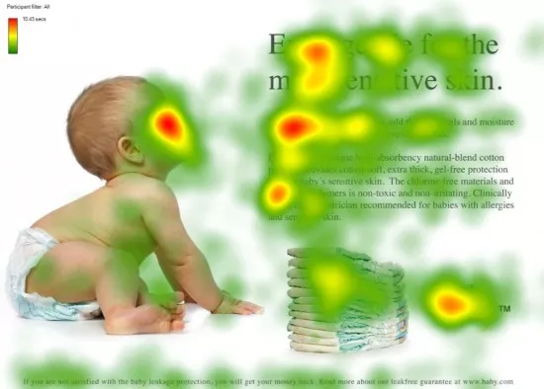
Attention
延时符

Slide 4
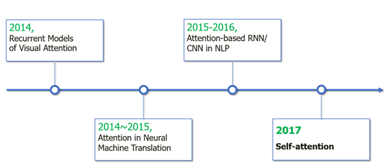
Attention
延时符

Slide 5
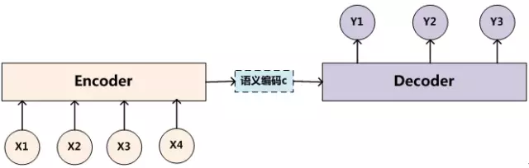
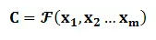
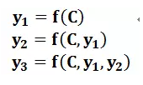
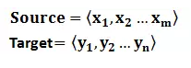
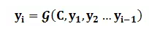
Encoder-Decoder
延时符

Slide 6
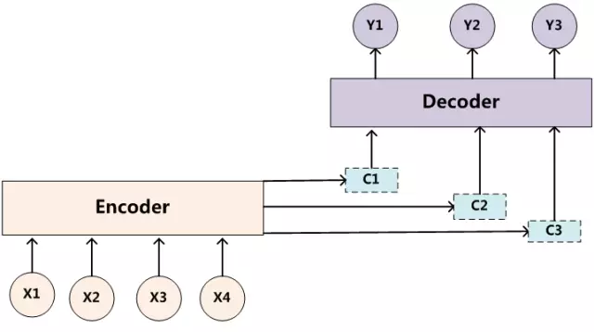
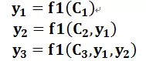
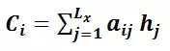
Encoder-Decode +Attention
延时符

Slide 7
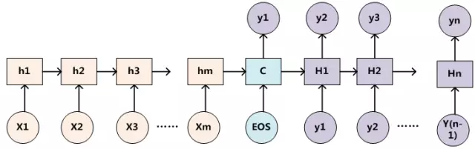
Encoder-Decoder with RNN
延时符

Slide 8
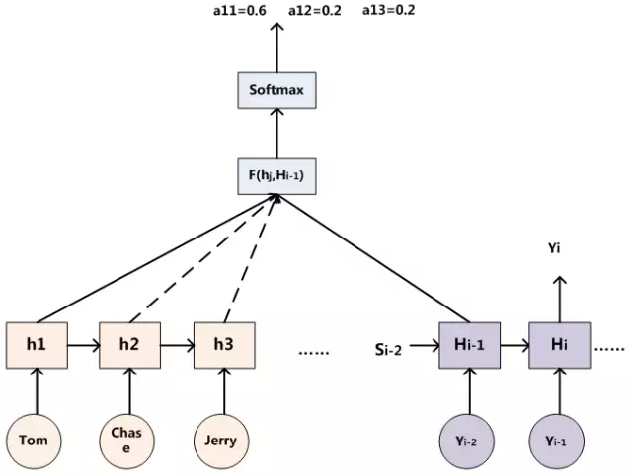
Encoder-Decoder with RNN + Attention
延时符

Slide 9
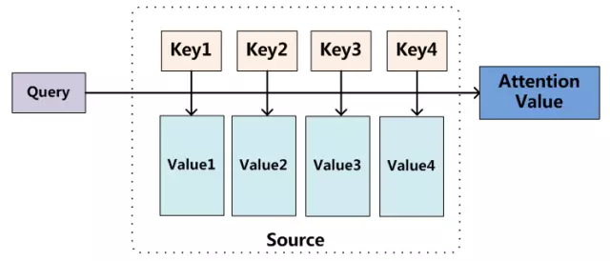
Attention 机制的本质思想
延时符

Slide 10
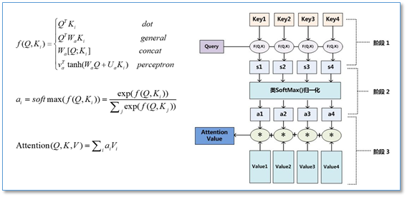
summary
延时符

Slide 11
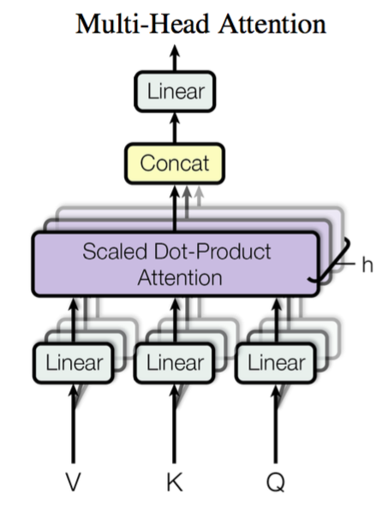
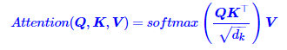
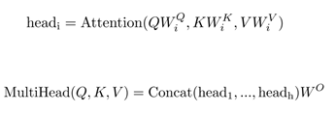
Self-Attention
Q=K=V
延时符

Slide 12
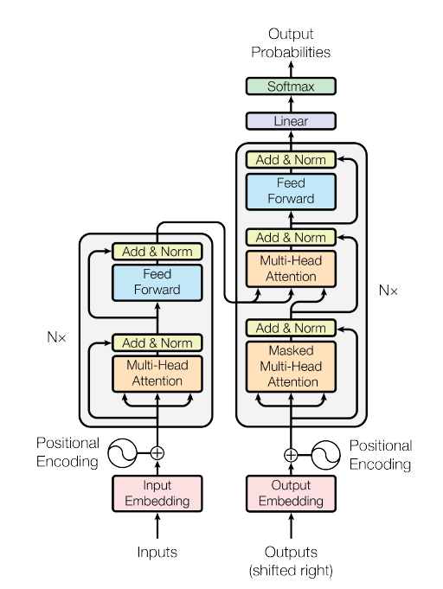
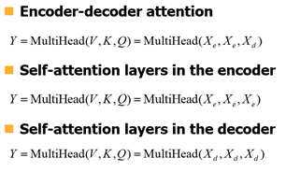
Transformer
延时符

Slide 13
参考资料
参考资料
https://www.cnblogs.com/robert-dlut/p/5952032.html
https://www.cnblogs.com/robert-dlut/p/8638283.html
https://kexue.fm/archives/4765
https://mp.weixin.qq.com/s?__biz=MzA4Mzc0NjkwNA==&mid=2650783542&idx=1&sn=3846652d54d48e315e31b59507e34e9e&chksm=87fad601b08d5f17f41b27bb21829ed2c2e511cf2049ba6f5c7244c6e4e1bd7144715faa8f67&mpshare=1&scene=1&srcid=1113JZIMxK3XhM9ViyBbYR76#rd
延时符
Notes:
。

Slide 14
Attention in NLP
汇报人：张璐 汇报时间：2018.12.5
延时符

